Slide 1
IBM University Engagement Project Submission
“Exploring the Power of Agentic AI with IBM Granite and IBM Bob”

Slide 2

Project Tile – PERITIA: AI-POWERED INTELLIGENT INTERVIEW TRAINER AGENT
Domain of Project – Education / Career Development/Agentic AI / Artificial Intelligence
Student Name | Recent Passport Photo | Email ID | Mobile number [WhatsApp]
SWAMINATHAN.S |  | neokritus.cli@gmail.com | +91 9360876964

Slide 3
Problem Statement:
Problem Statement No.22 – Interview Trainer Agent
PERITIA: AN AI-POWERED RAG-BASED INTELLIGENT INTERVIEW TRAINER AGENT FOR PERSONALIZED, ROLE-SPECIFIC TECHNICAL AND BEHAVIORAL INTERVIEW PREPARATION
The Challenge
Preparing for interviews is difficult because relevant technical questions, behavioral scenarios, HR guidance, and role expectations are scattered across different sources. Candidates often receive generic preparation that does not consider their target role, experience level, skills, or resume. Without personalized practice and structured feedback, it is difficult to identify strengths and improve interview performance.
The Objective
Build an AI-powered Interview Trainer Agent that delivers personalized interview preparation based on the user's profile, experience level, target role, skills, and resume. The solution should:
• Personalized Interview Preparation – Generate role-specific technical, behavioral, and HR questions.
• RAG-Based Retrieval – Retrieve relevant interview knowledge and role-specific guidance.
• Interactive Practice – Conduct one-question-at-a-time interview practice.
• Answer Evaluation – Evaluate responses and provide strengths, missing points, and improvement suggestions.
• Performance Tracking – Track interview progress and provide an overall performance summary.

Slide 4
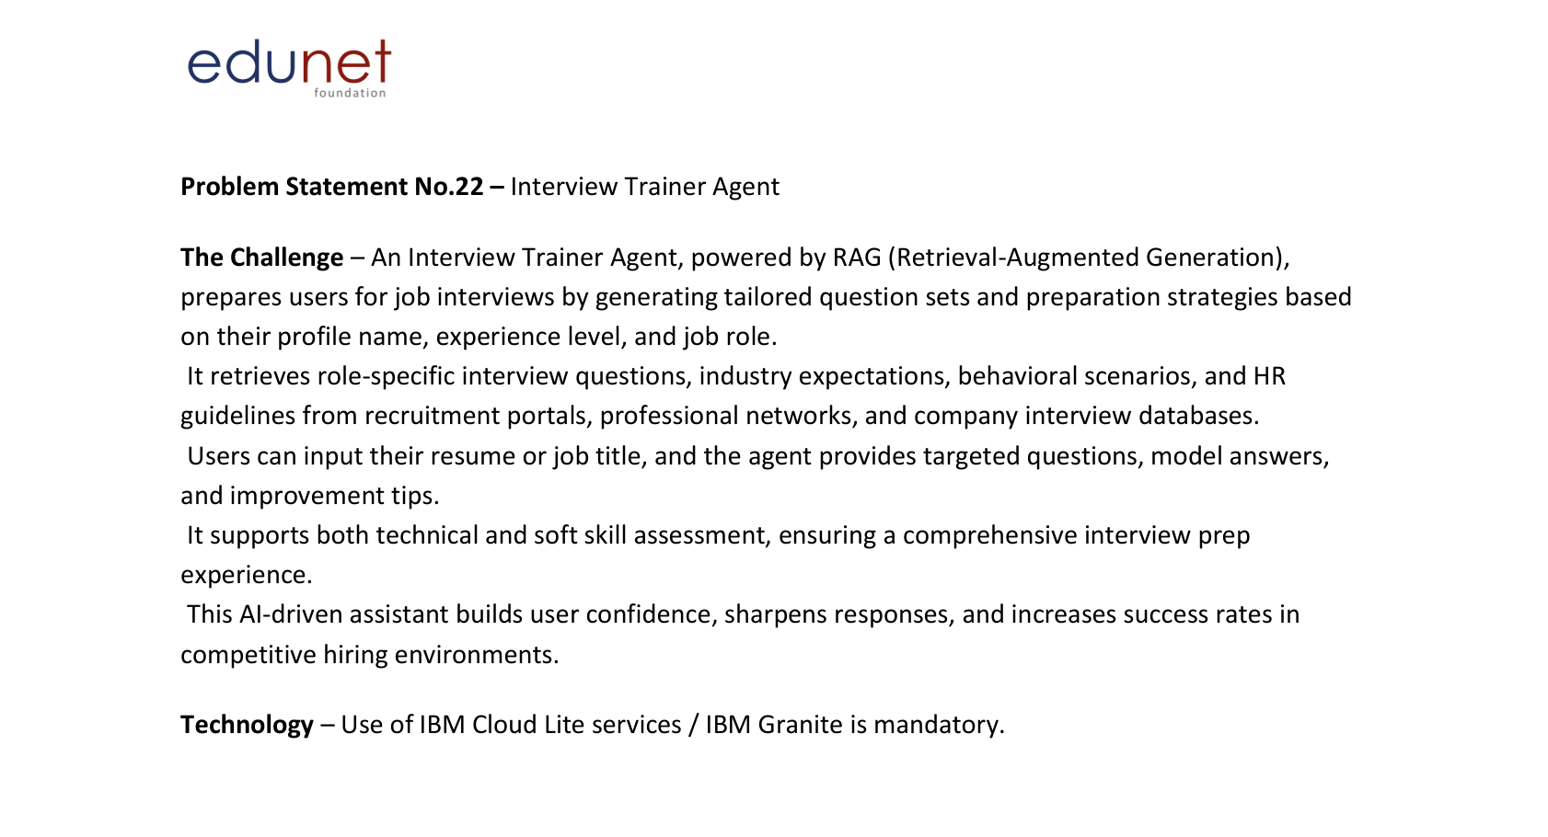
Problem Statement:

Slide 5
Proposed Solution:
Proposed Solution: AI-Powered Interview Trainer Agent
The proposed solution is an AI-powered interview training platform built using IBM Bob, IBM watsonx.ai, RAG, and foundation models to provide personalized, role-specific interview preparation.
At its core, the solution uses a Retrieval-Augmented Generation (RAG) pipeline to retrieve relevant technical questions, behavioral scenarios, HR guidance, and role-specific interview knowledge from a curated knowledge base before generating personalized responses.
The system consists of five key components:
Profile Analyzer analyzes the user's profile, experience, skills, resume, and target role.
Interview Planner creates a personalized preparation plan based on the candidate's requirements.
Knowledge Retriever retrieves relevant interview information using RAG.
Question Generator generates technical, behavioral, HR, and role-specific interview questions.
Answer Evaluator analyzes user responses and provides strengths, missing points, model answers, and improvement suggestions.
The solution includes an interactive practice interface and performance dashboard to help candidates prepare, practice, receive feedback, and track their interview progress.

Slide 6
Technology Used
• IBM Bob platform – For designing and orchestrating the application workflow
• Foundation Model (IBM watsonx.ai) – For natural language understanding, reasoning, question generation, and answer evaluation
• IBM Cloud – Provides the infrastructure for running and integrating the application
• RAG – Retrieves relevant interview knowledge before generating personalized responses
• IBM watsonx.ai – For foundation model inference and AI integration
• Vector Database (FAISS) – For lightweight RAG-based interview knowledge retrieval
• React + FastAPI – For the web interface and backend application services

Slide 7
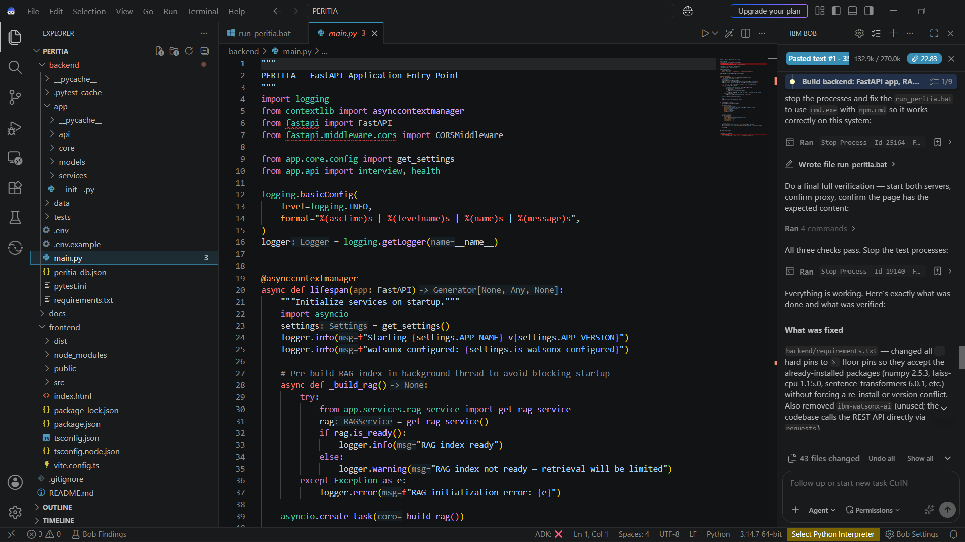
Required Files created using IBM bob -

Slide 8
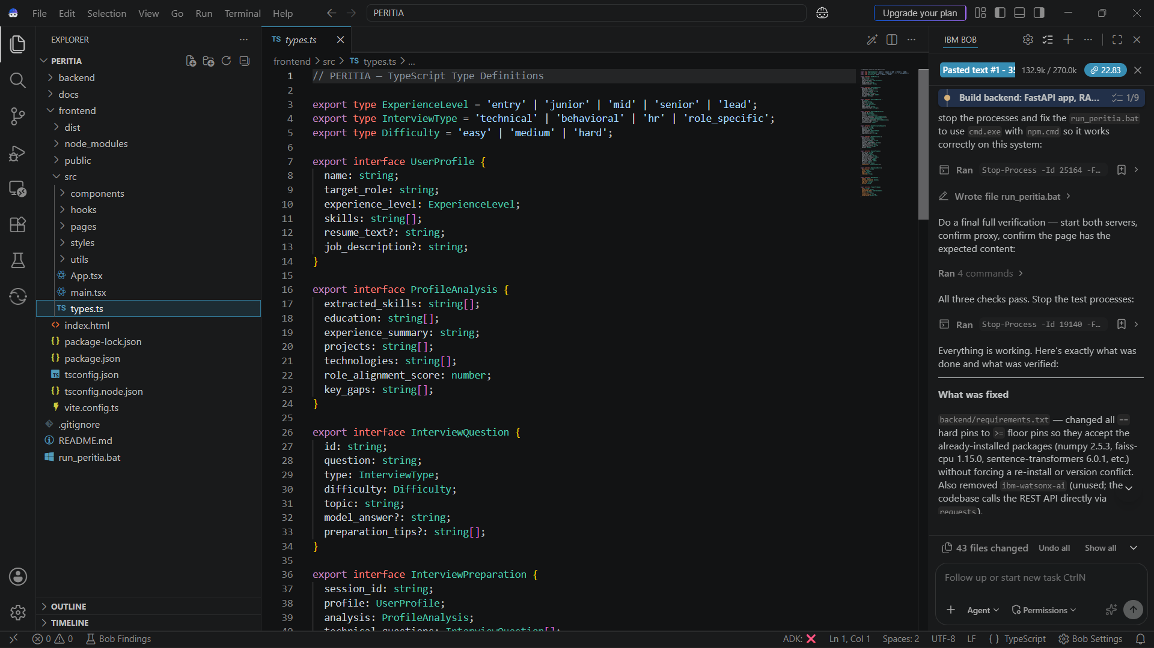
Required Files created using IBM bob -

Slide 9
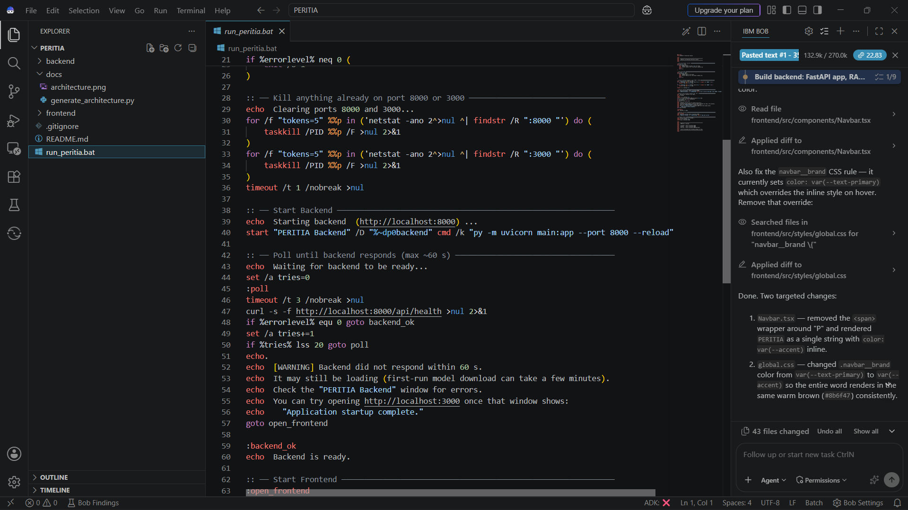
Required Files created using IBM bob -

Slide 10
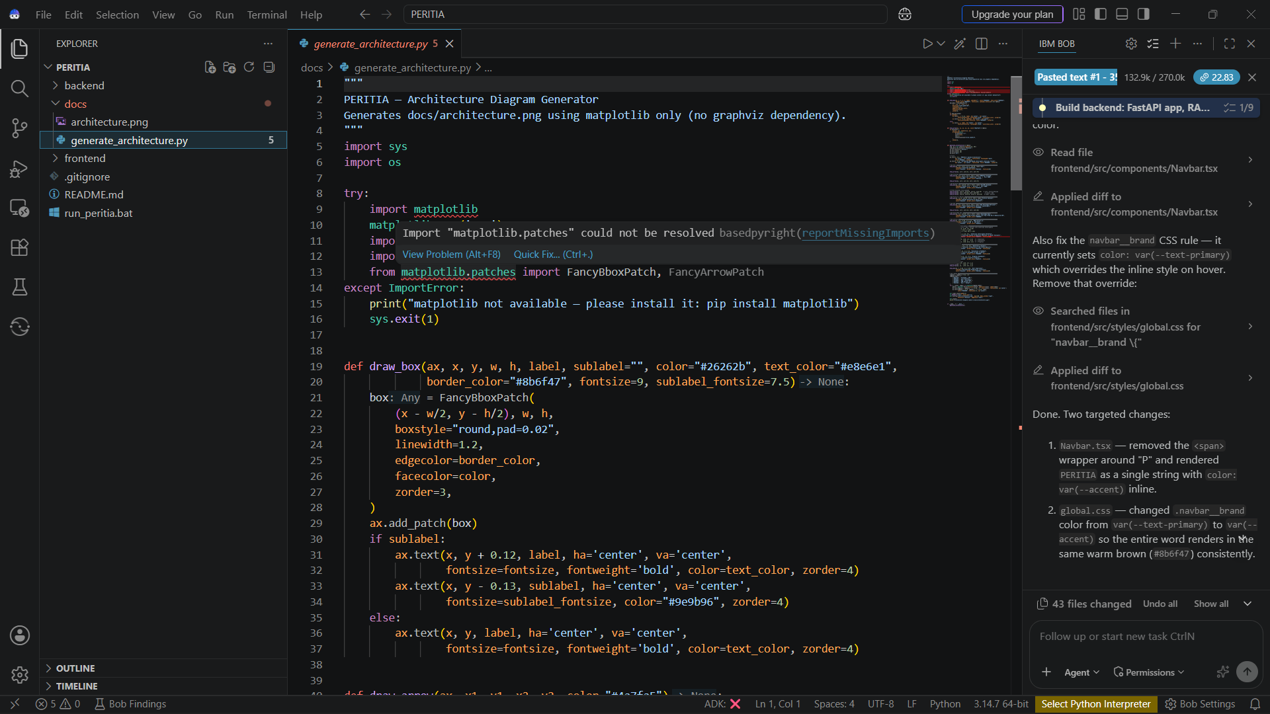
Required Files created using IBM bob -

Slide 11
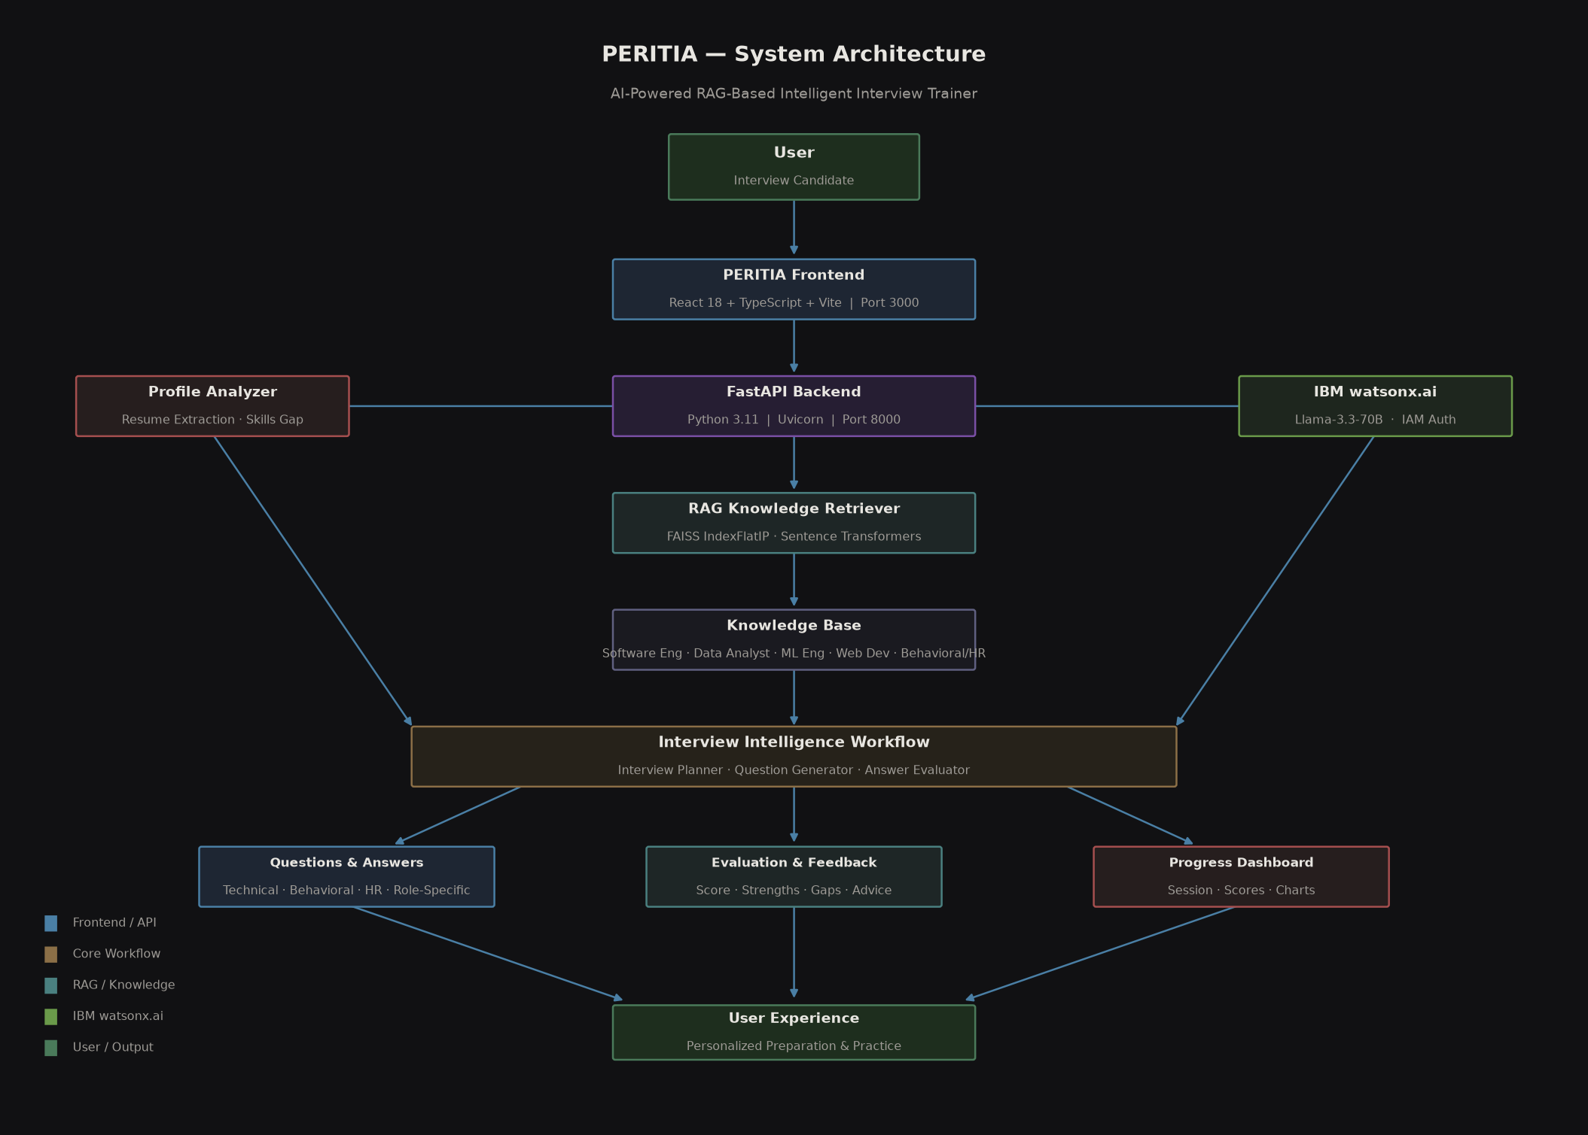
Architecture blueprint for IBM bob:

Slide 12

Role of Agentic AI in the solution
Role of Agentic AI in PERITIA
Agentic AI enables PERITIA to function as an intelligent interview-training system rather than a simple chatbot. Using IBM watsonx.ai, it coordinates the different stages of the interview preparation workflow to provide personalized, role-specific guidance.
The system performs specialized tasks such as analyzing the user's profile and resume, retrieving relevant interview knowledge, generating technical and behavioral questions, evaluating answers, and providing personalized improvement feedback. These components work together to deliver a structured interview preparation experience.
Agentic AI also provides context awareness by considering the user's target role, experience level, skills, resume, and job description when generating interview content. This enables personalized question selection and **real-time adaptation** during interview practice.
The workflow supports continuous assessment by analyzing each submitted answer and identifying **strengths, missing points, and areas for improvement**. This helps users progressively improve their technical and behavioral interview performance.
Overall, Agentic AI makes PERITIA a personalized, goal-driven interview trainer that guides users from preparation through practice, evaluation, and performance improvement.

Slide 13
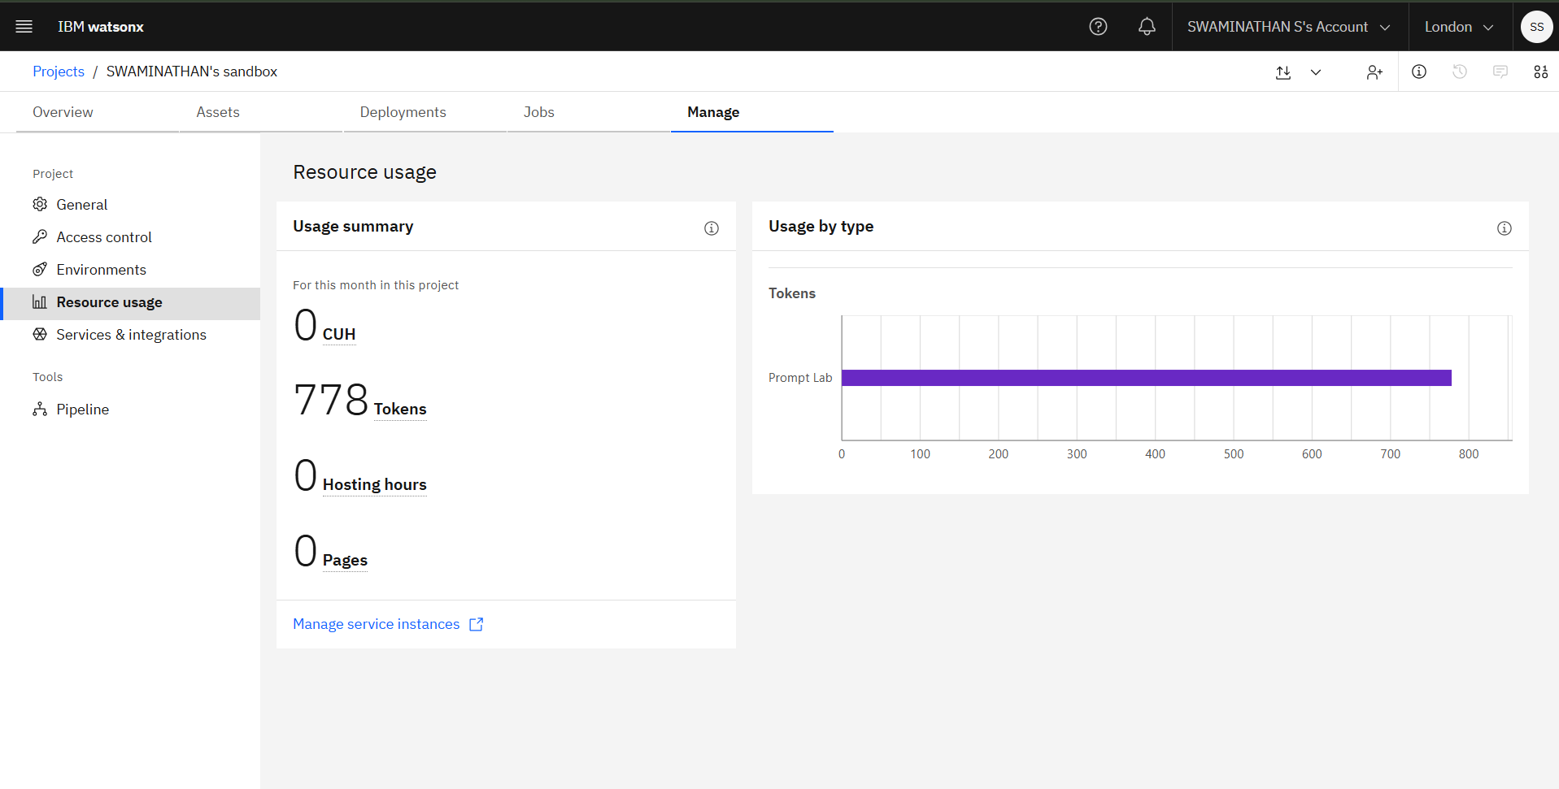

Token Usage
9,196 token are used
Before Prompt
After the Prompt
·
·
·

Slide 14
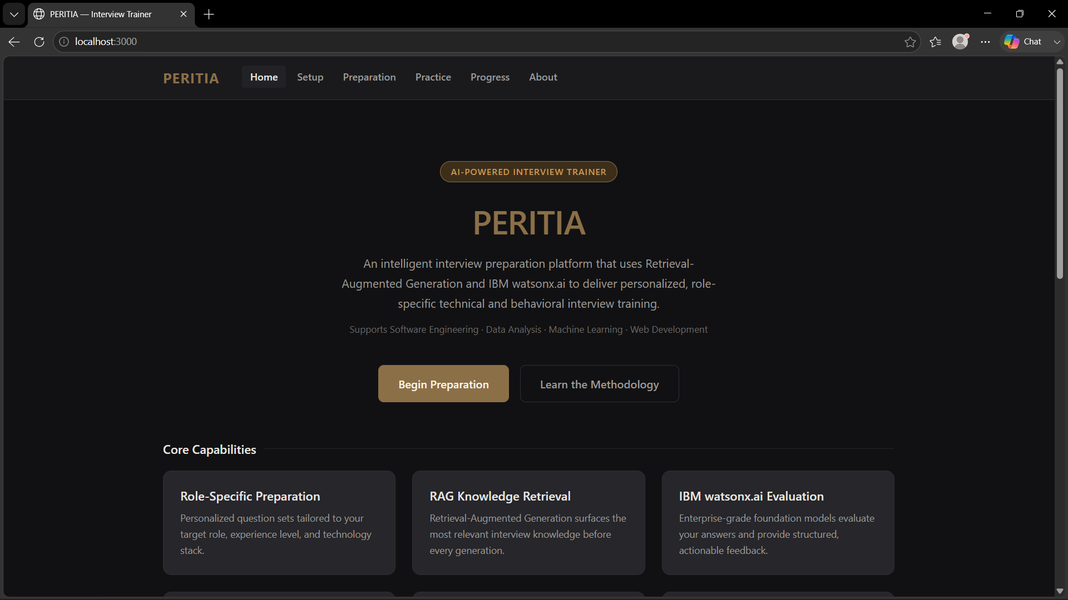
Project Output Screenshot
Please put IBM Bob output screenshots with 2-3 prompts.
You can take 2-3 more slides for each screenshot
·
·
·

Slide 15
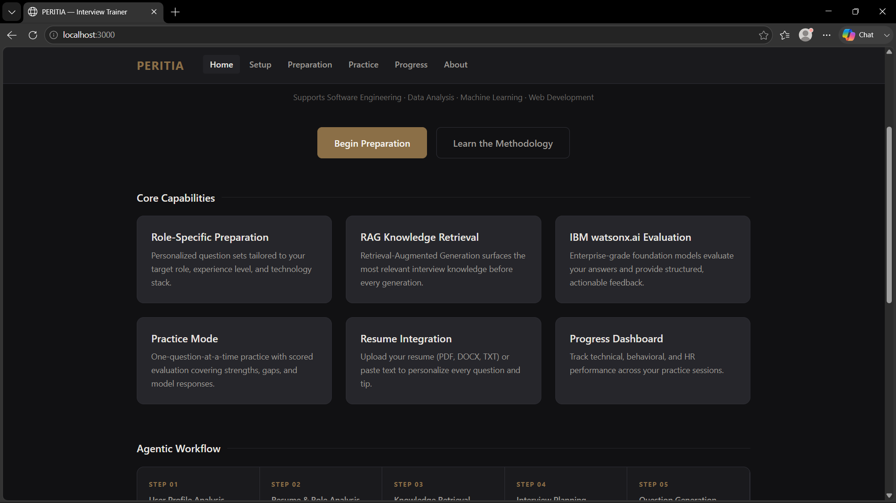
Project Output Screenshot
Please put IBM Bob output screenshots with 2-3 prompts.
You can take 2-3 more slides for each screenshot
·
·
·

Slide 16
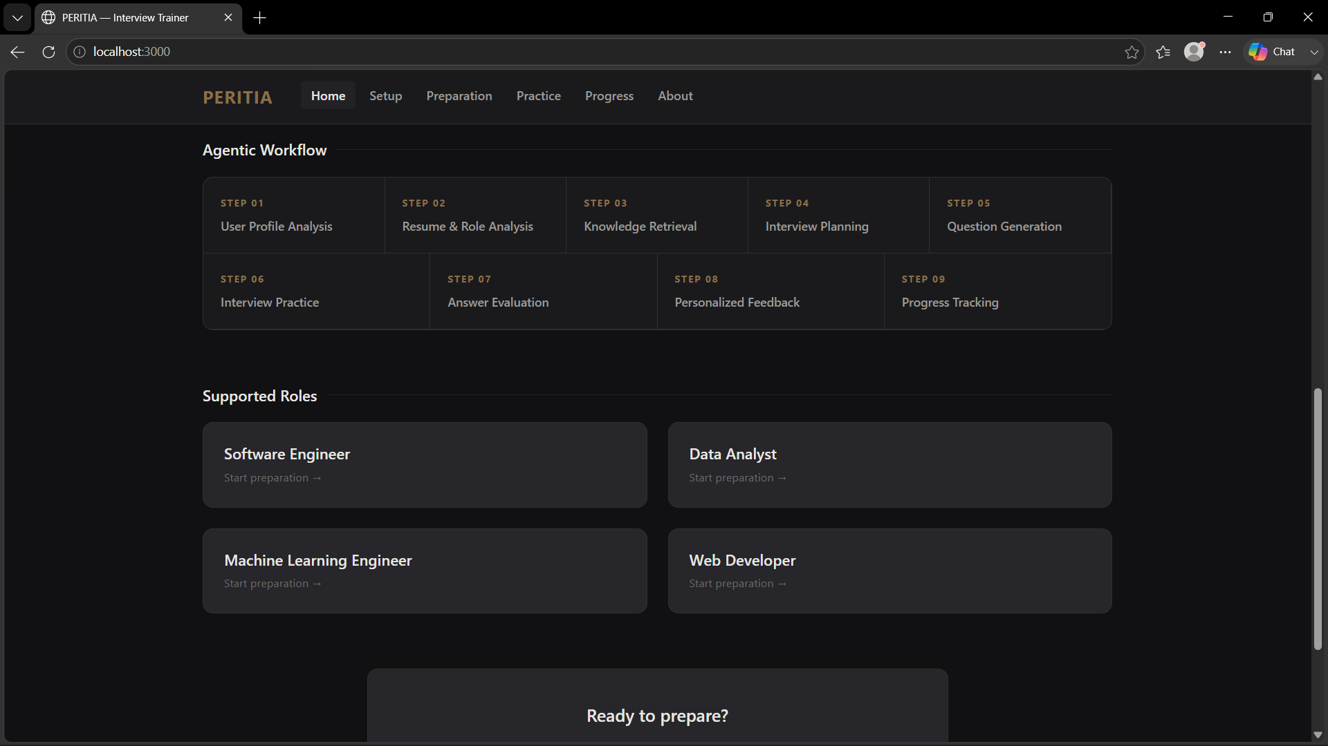
Project Output Screenshot
Please put IBM Bob output screenshots with 2-3 prompts.
You can take 2-3 more slides for each screenshot
·
·
·

Slide 17
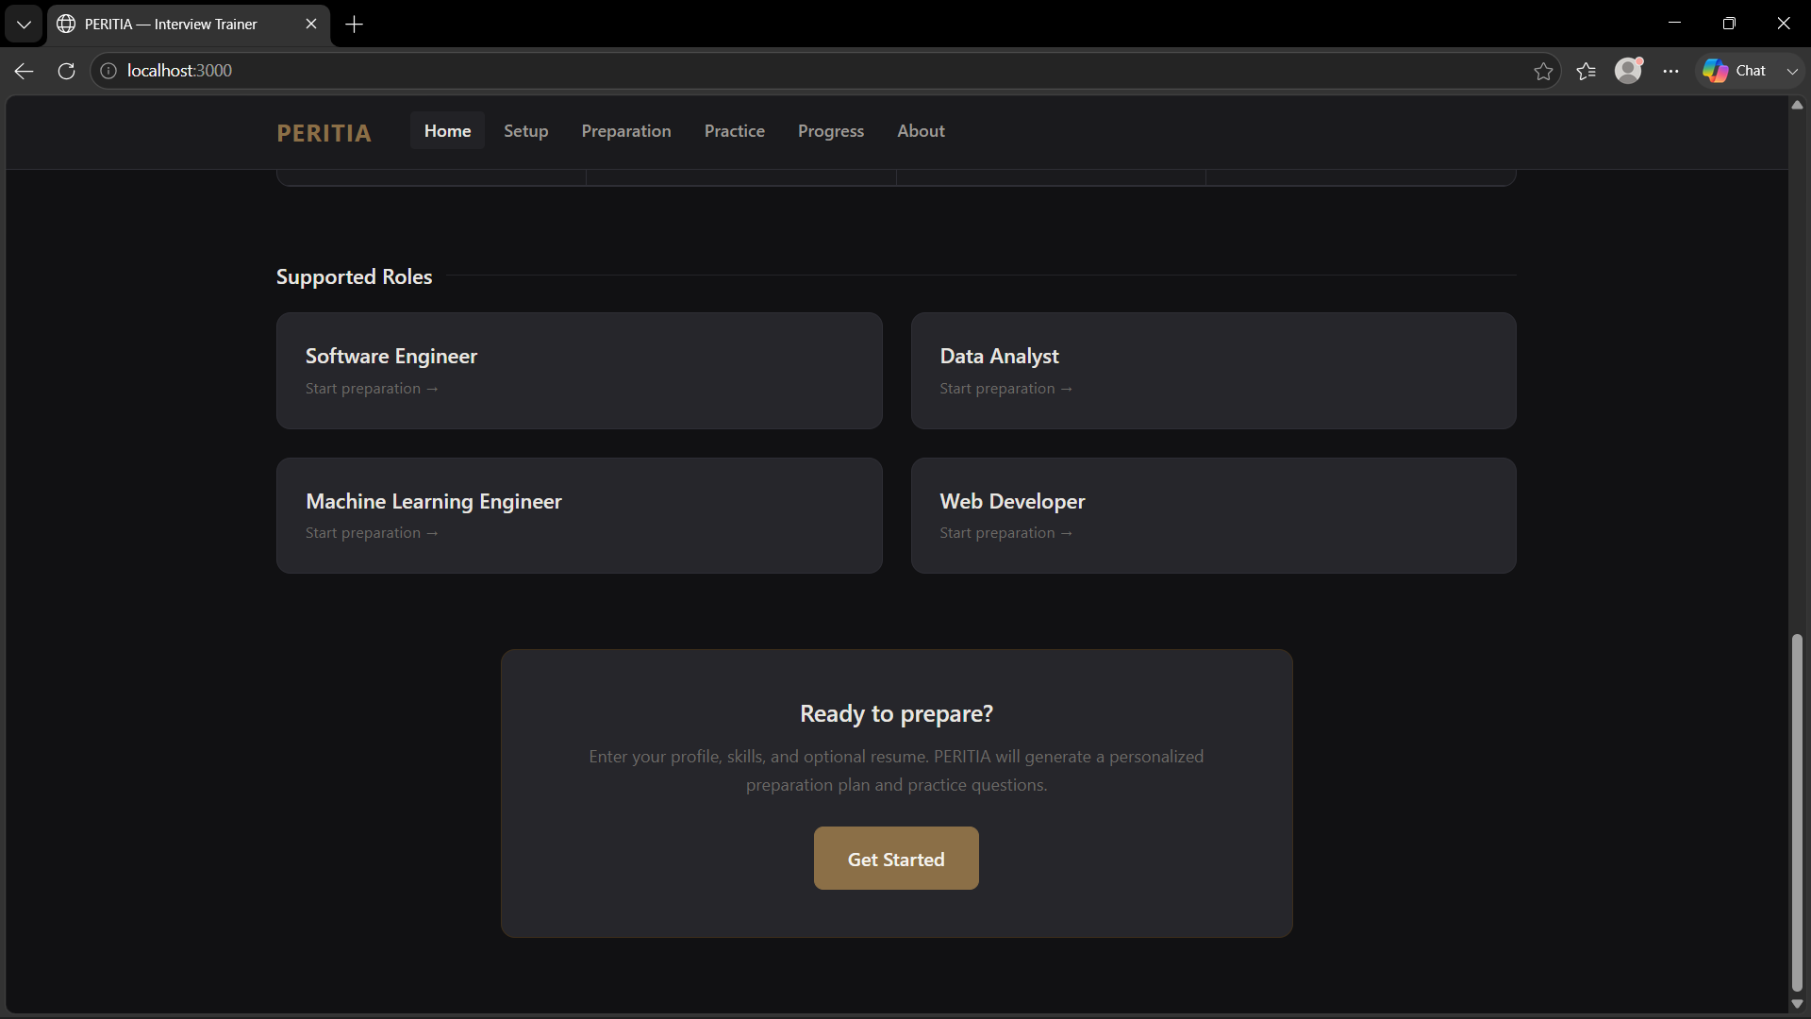
Project Output Screenshot
Please put IBM Bob output screenshots with 2-3 prompts.
You can take 2-3 more slides for each screenshot
·
·
·

Slide 18
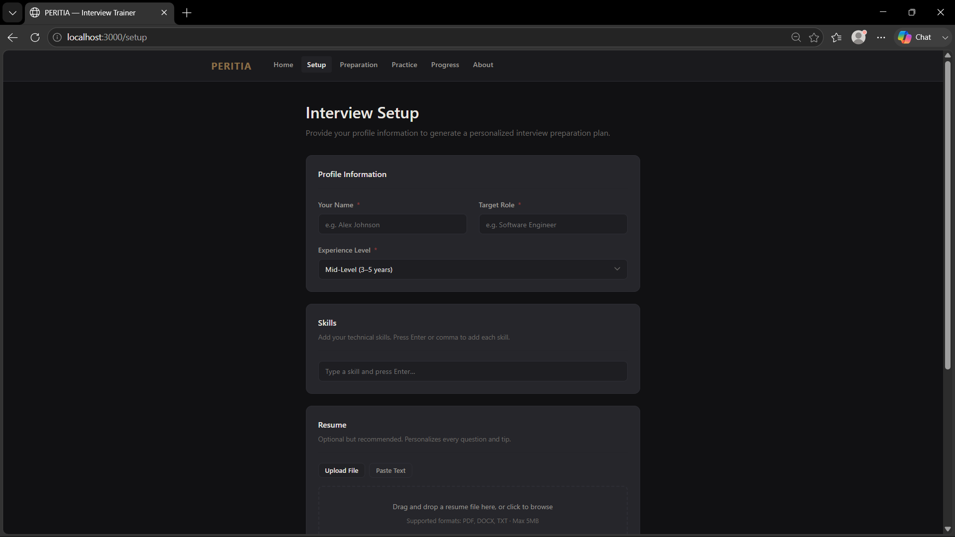
Project Output Screenshot
Please put IBM Bob output screenshots with 2-3 prompts.
You can take 2-3 more slides for each screenshot
·
·
·

Slide 19
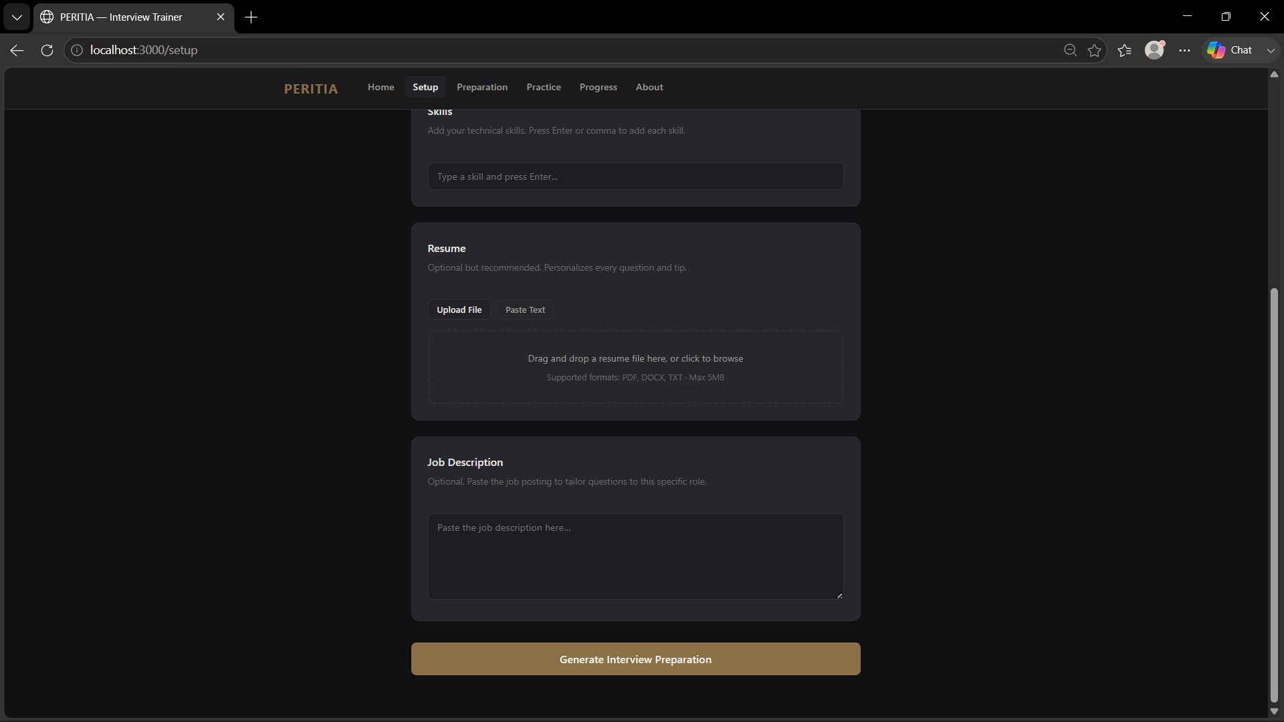
Project Output Screenshot
Please put IBM Bob output screenshots with 2-3 prompts.
You can take 2-3 more slides for each screenshot
·
·
·

Slide 20
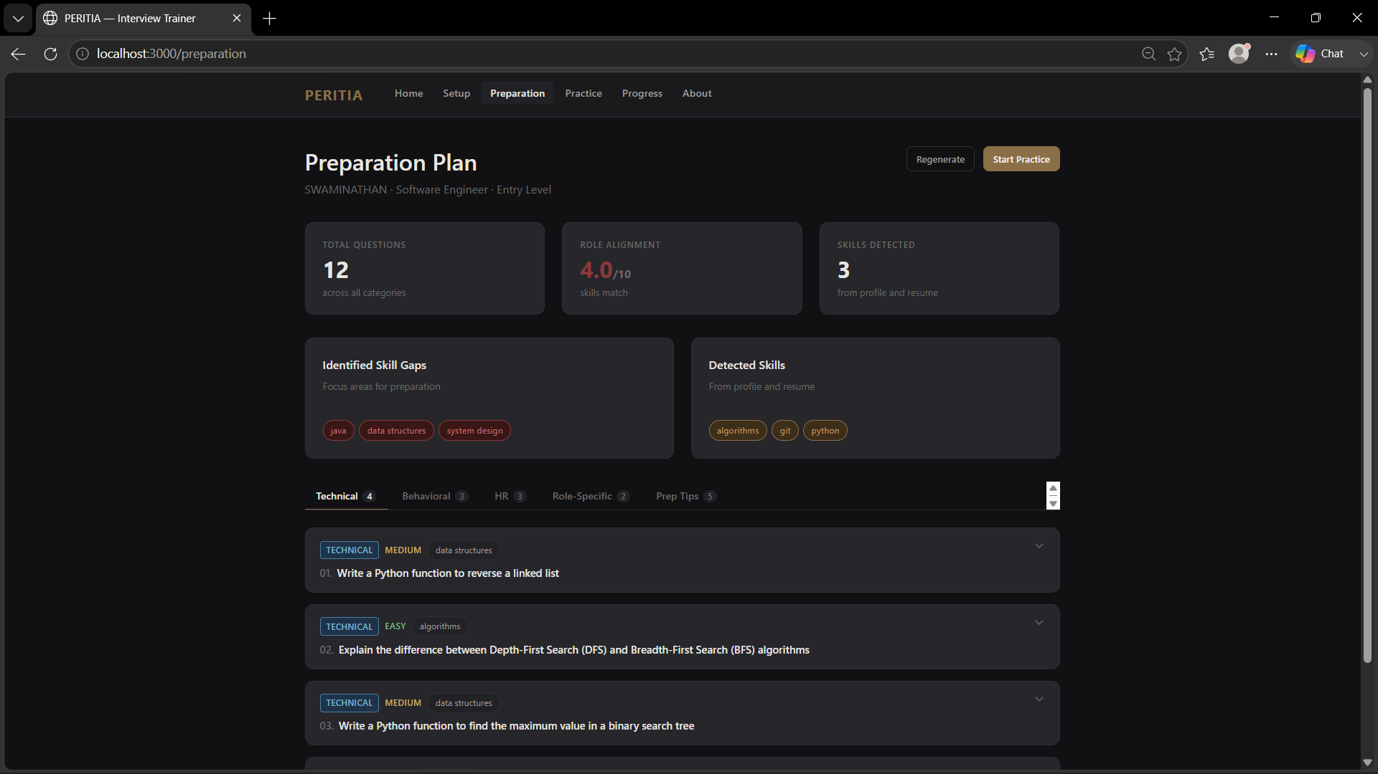
Project Output Screenshot
Please put IBM Bob output screenshots with 2-3 prompts.
You can take 2-3 more slides for each screenshot
·
·
·

Slide 21
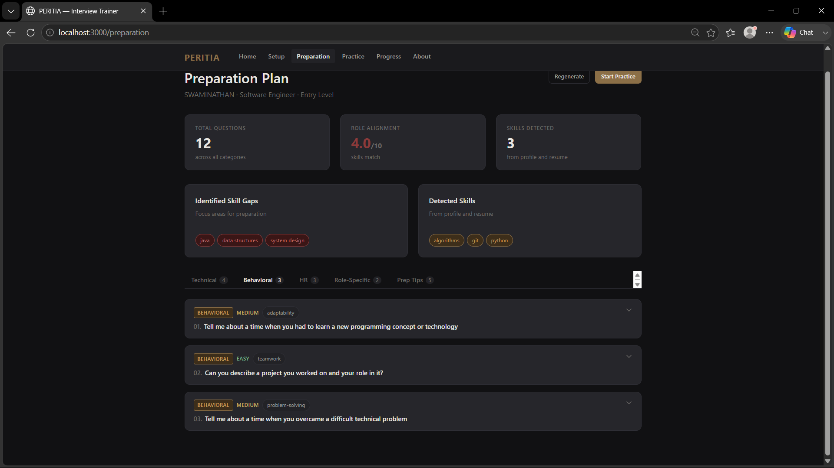
Project Output Screenshot
Please put IBM Bob output screenshots with 2-3 prompts.
You can take 2-3 more slides for each screenshot
·
·
·

Slide 22
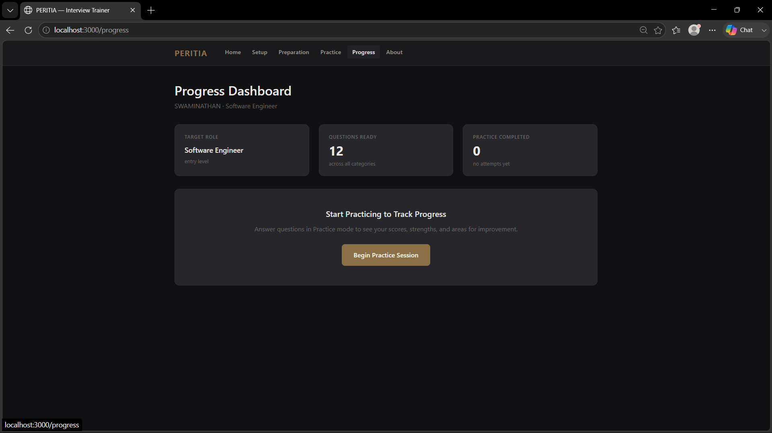
Project Output Screenshot
Please put IBM Bob output screenshots with 2-3 prompts.
You can take 2-3 more slides for each screenshot
·
·
·

Slide 23
Novelty and Uniqueness
PERITIA combines Agentic AI, RAG, and personalization into a single intelligent interview-training system.
Role-Specific Intelligence – Generates interview preparation based on the user's target role, experience level, skills, resume, and job description.
RAG-Based Preparation – Retrieves relevant interview knowledge before generating questions and feedback, improving contextual relevance.
Personalized Interview Practice – Adapts technical, behavioral, and HR questions according to the user's profile and selected role.
Answer Evaluation Loop – Evaluates each response and identifies strengths, missing points, weaknesses, and areas for improvement.
Resume-Aware Training – Uses information from the user's resume to create more relevant and personalized interview questions.
Unified Interview Workflow – Integrates preparation, practice, evaluation, and progress tracking into one platform.
IBM watsonx.ai Integration – Uses an IBM watsonx.ai foundation model (LLaMA / Granite) for question generation and answer evaluation.
This makes PERITIA a structured, adaptive, and personalized interview-training platform rather than a basic question-and-answer chatbot.

Slide 24
Git Hub Link
• Public GitHub Repository – PERITIA
Please test and paste the working GitHub URL – https://github.com/NeoKritus/PERITIA
Project Repository Contents:
1) PERITIA Source Code
2) README.md
3) Problem Statement
4) System Architecture
5) RAG Knowledge Base
6) IBM Bob / Agent Files
7) Project Presentation
8) Configuration and Supporting Files
·
·
·

Slide 25
Future Scope
1. Advanced Resume & Job Description Analysis –
The system can be enhanced to perform deeper analysis of resumes and job descriptions, identifying skill gaps and matching candidate profiles with role-specific interview requirements. This will enable more targeted preparation and personalized question generation.
2. Multilingual & Voice-Based Interview Practice –
Future versions can support multiple languages and voice-based interaction, allowing users to practice spoken interview responses naturally. This can improve accessibility and help users strengthen both technical communication and behavioral responses.
·
·
·

Slide 26
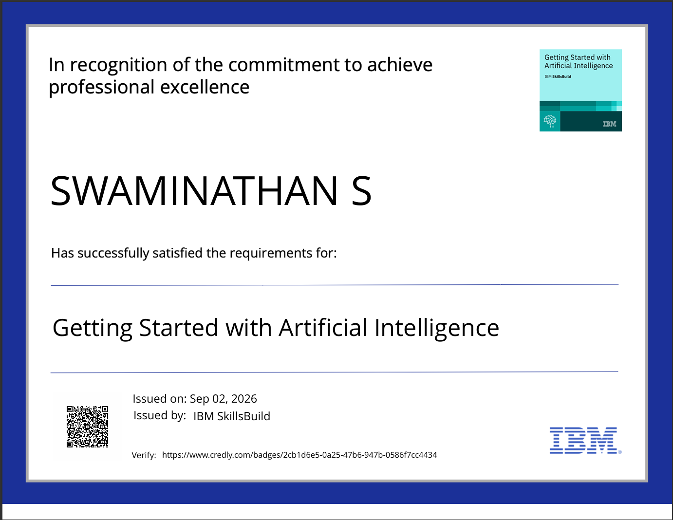
Certificates Earned:
Getting Started with Artificial Intelligence

Slide 27
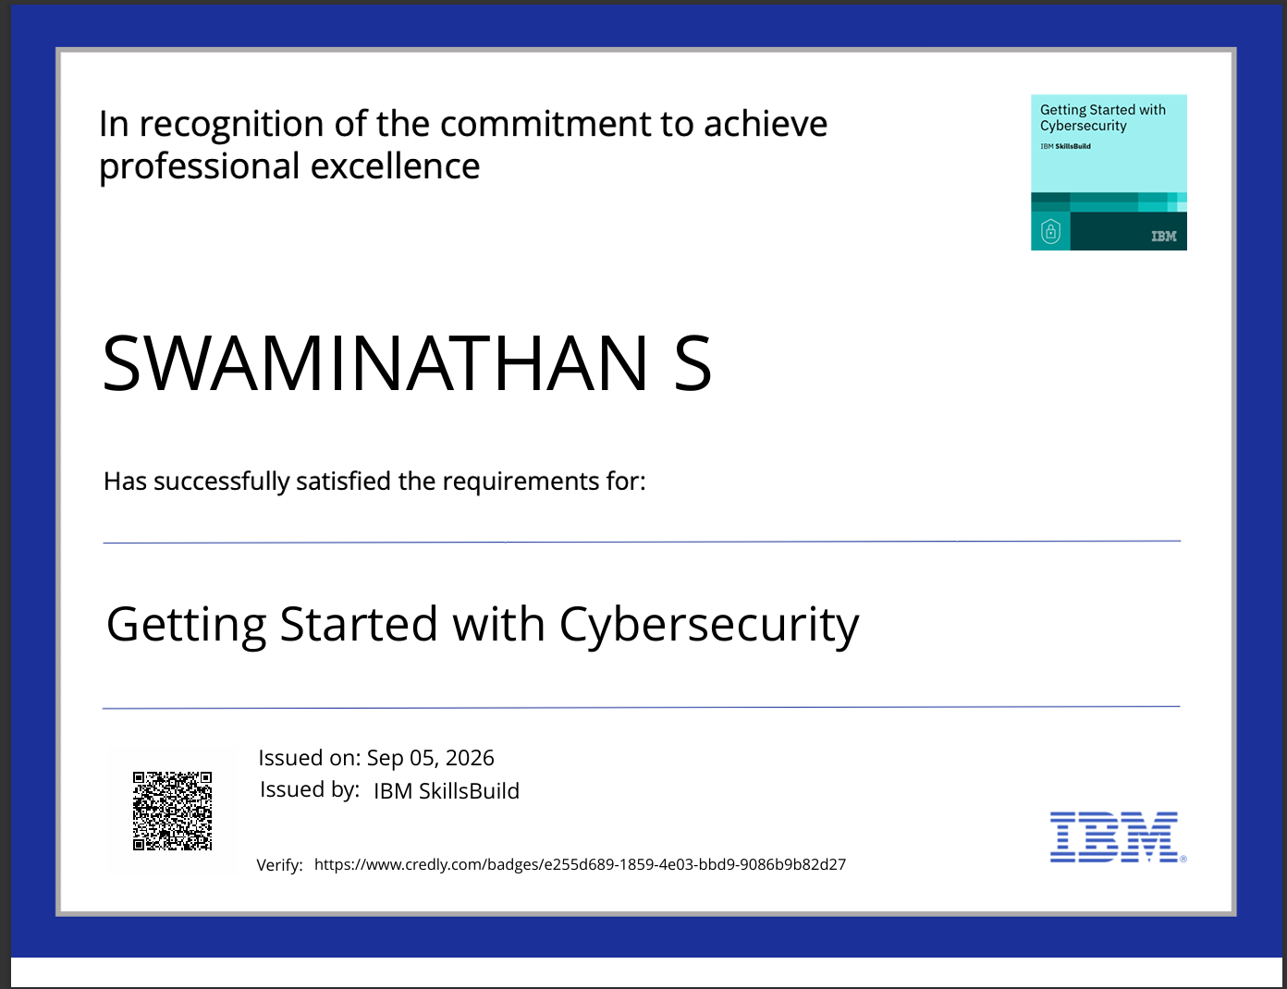
Certificates Earned:
Getting Started with Cybersecurity

Slide 28
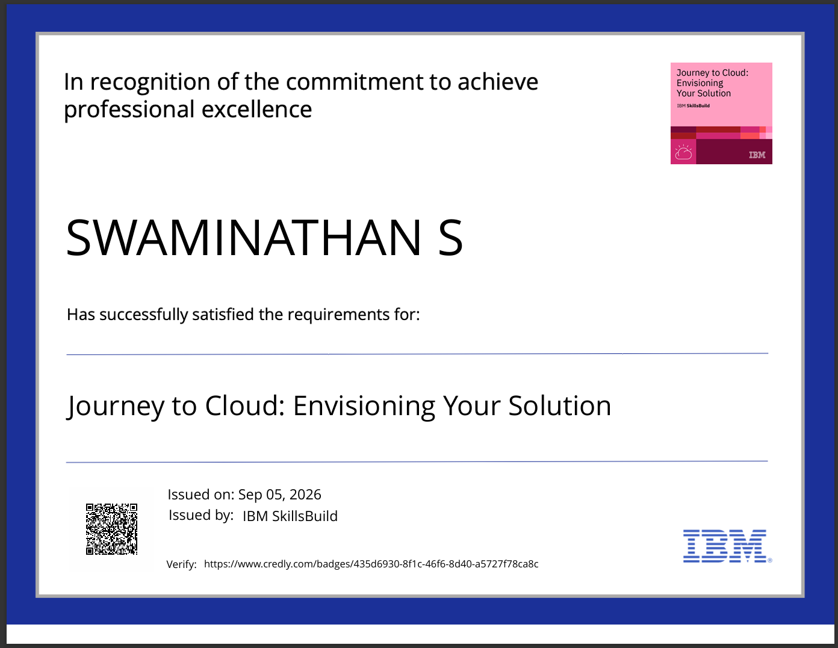
Certificates Earned:
Journey to Cloud: Envisioning Your Solution

Slide 29
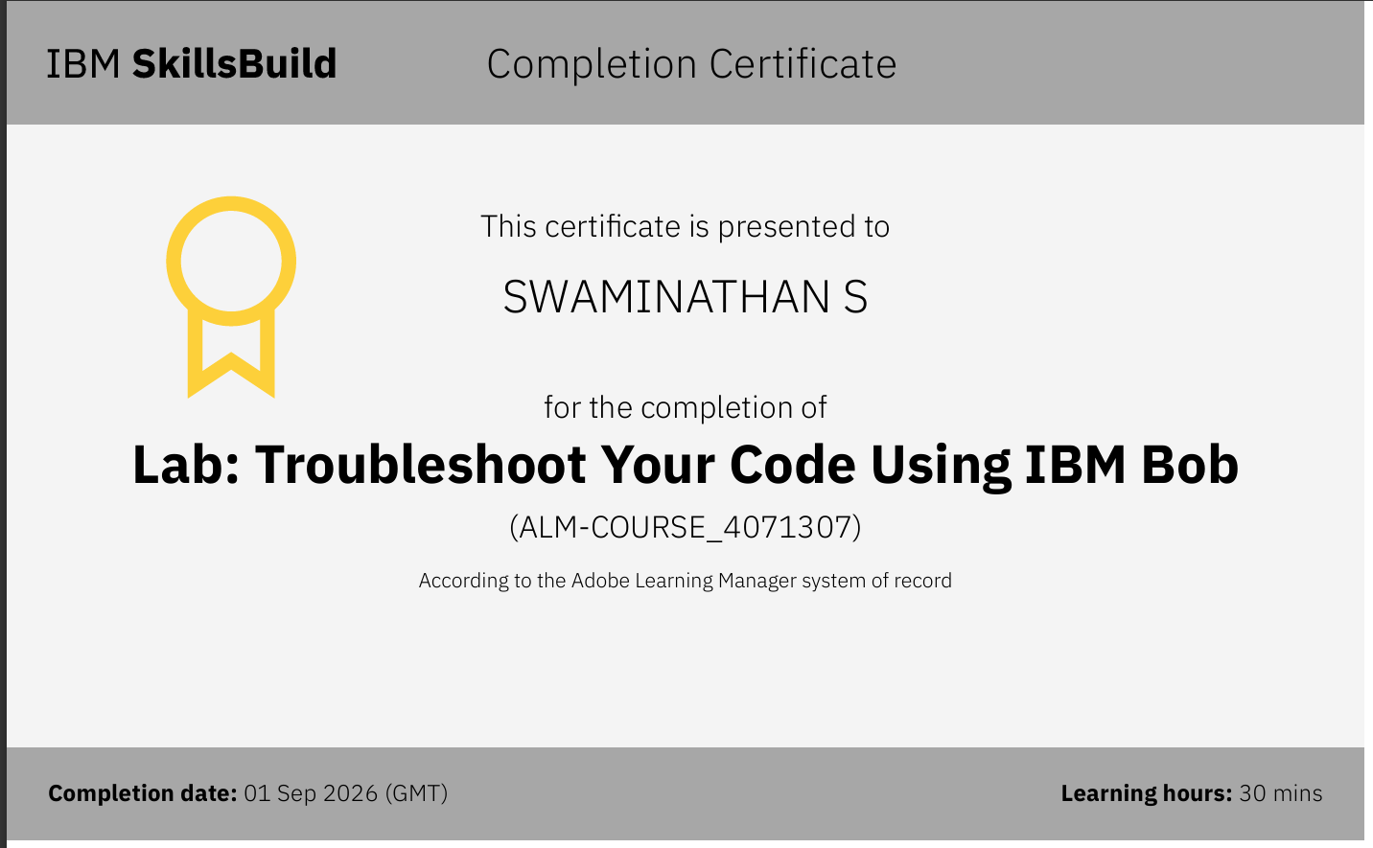
Certificates Earned:​
IBM BOB:

Slide 30


